Slide 1
Row dimming artifact

Slide 2
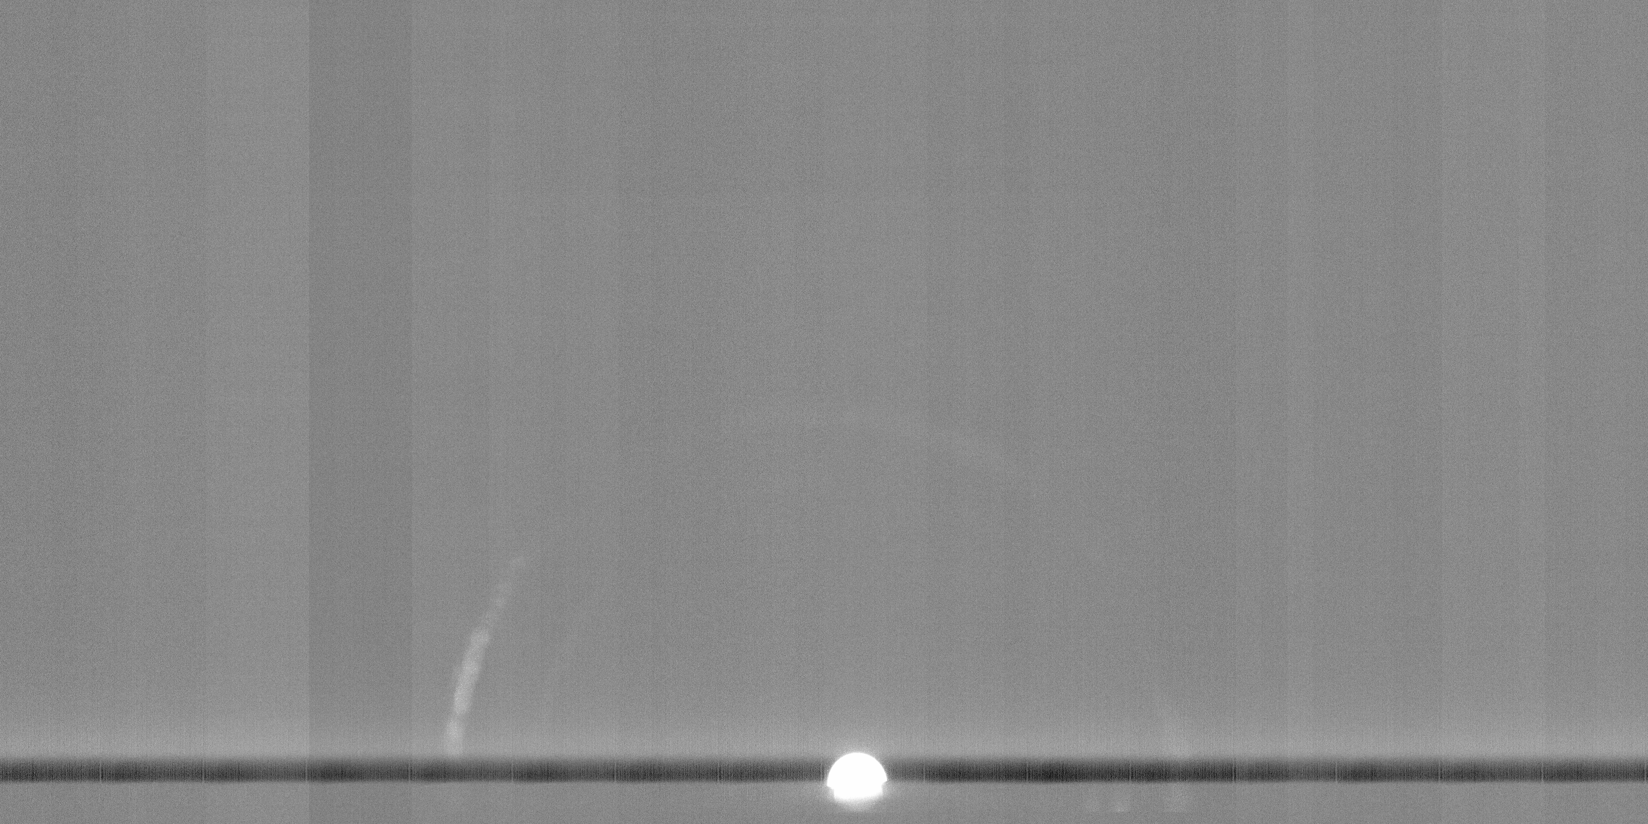
Row Dimming Artifact

Slide 3

20220518 194535 WAC MTF TARGET 3X3 WHITE 0.5X on Axis (No correction)

Slide 4
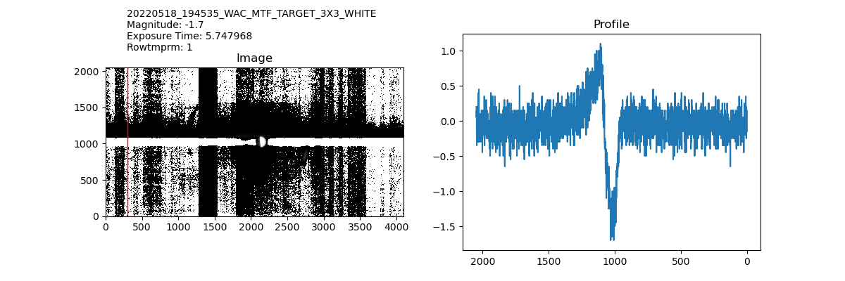
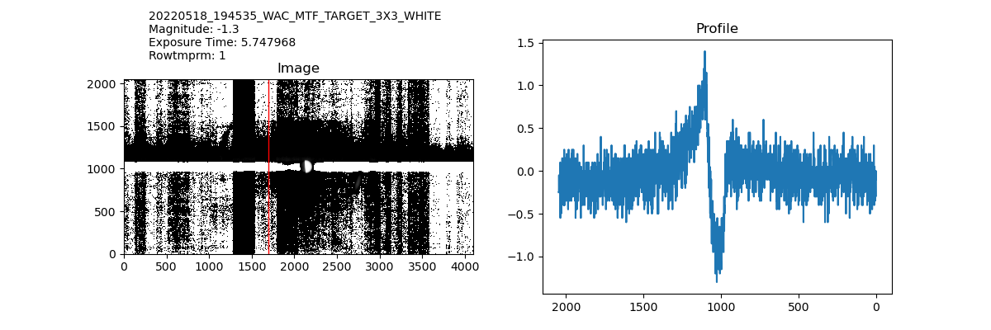
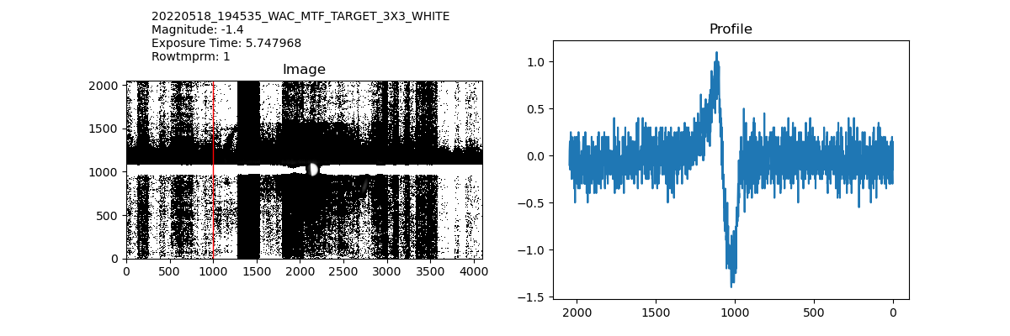
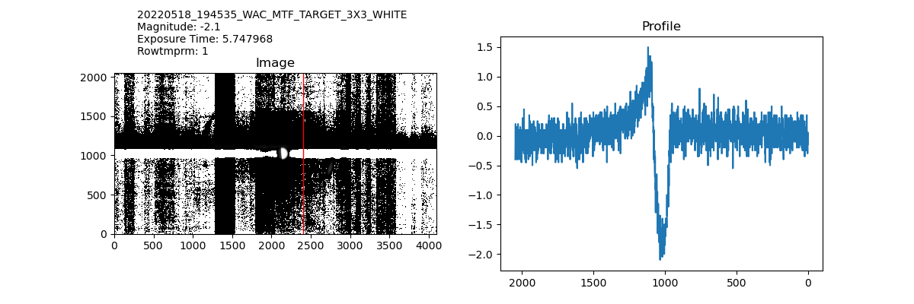
20220518 194535 WAC MTF TARGET 3X3 WHITE 0.5X on Axis (Dark Corrected)

Slide 5
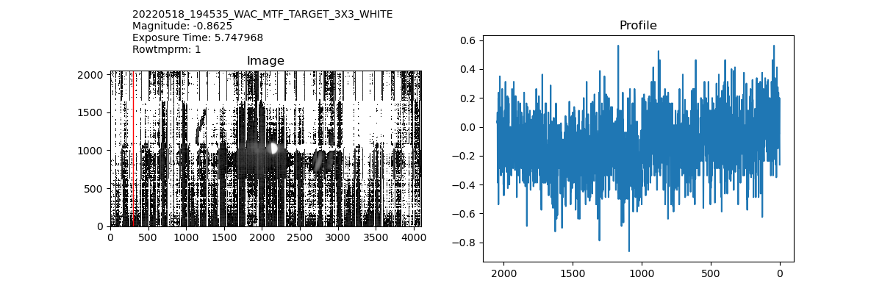
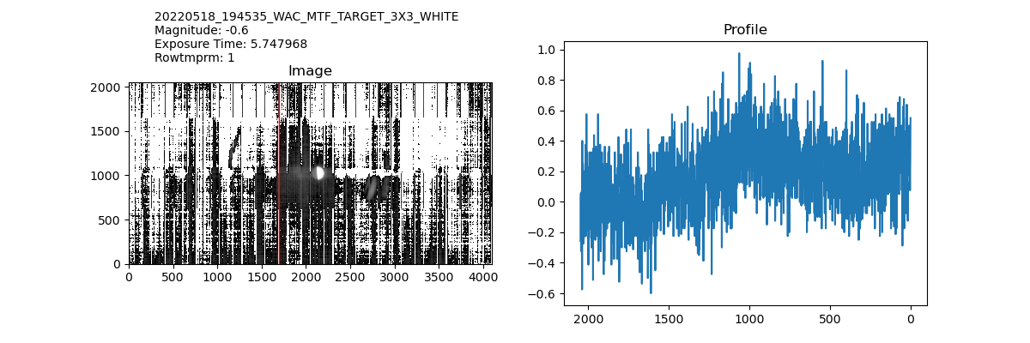
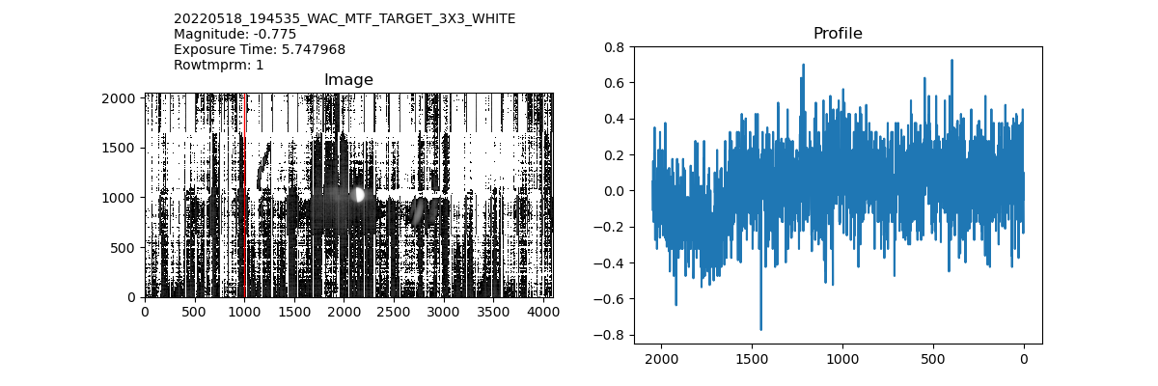
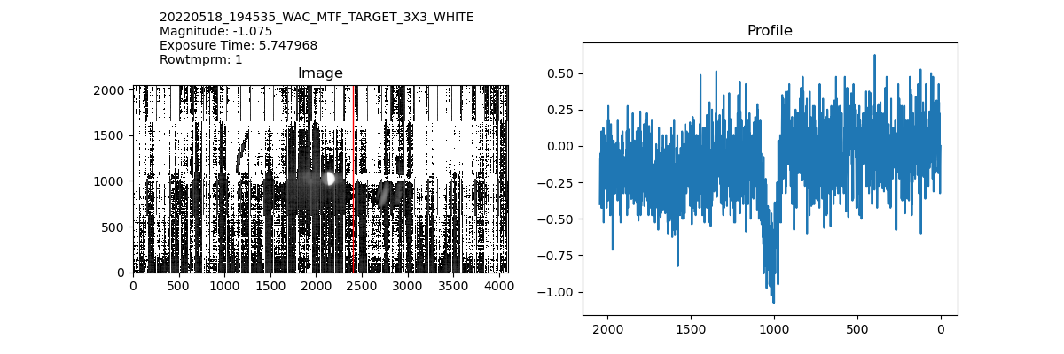
20220518 194535 WAC MTF TARGET 3X3 WHITE 0.5X on Axis (PF Corrected)

Slide 6
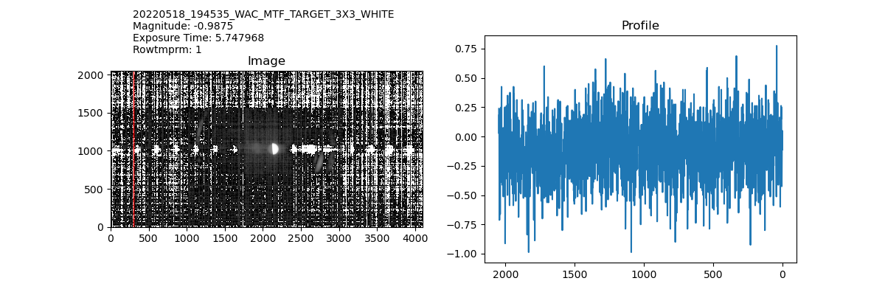
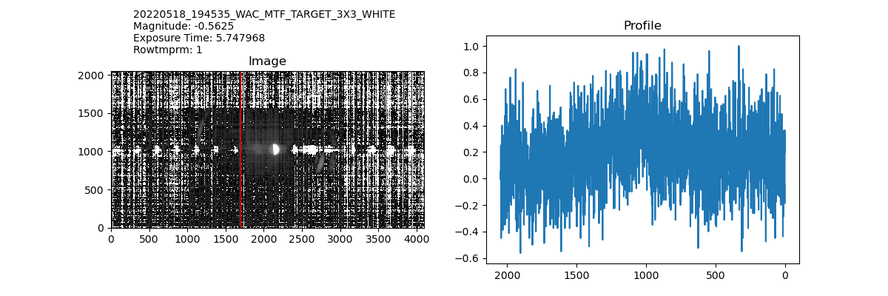
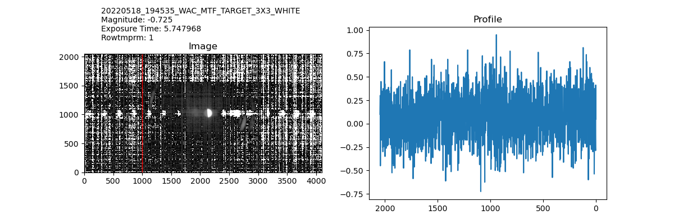
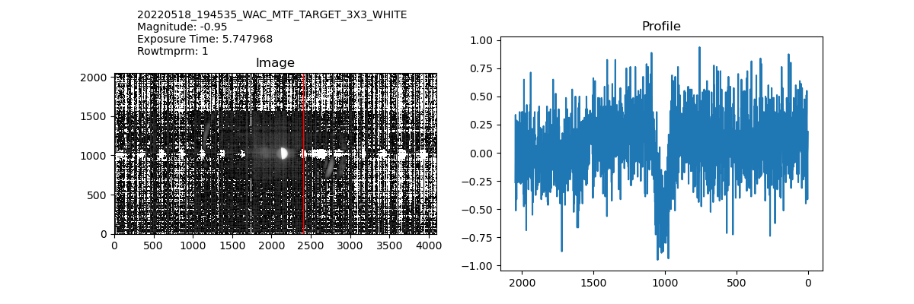
20220518 194535 WAC MTF TARGET 3X3 WHITE 0.5X on Axis (Dark + PF Corrected)

Slide 7
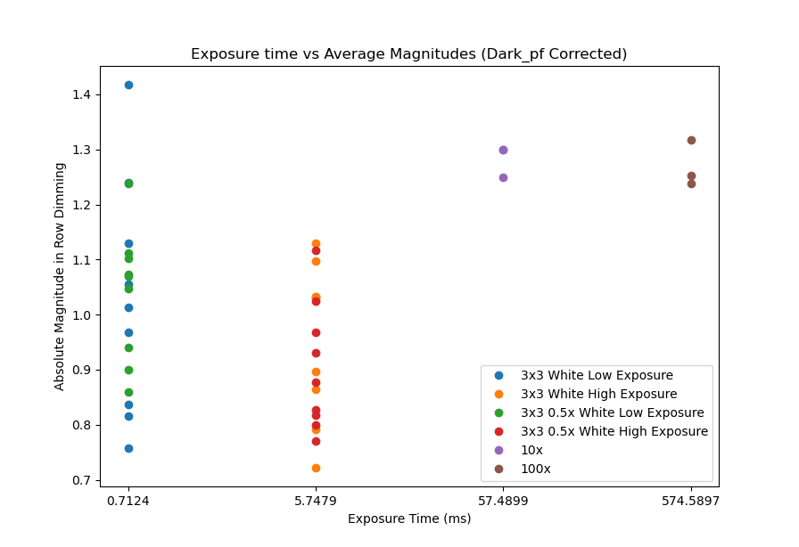

Slide 8
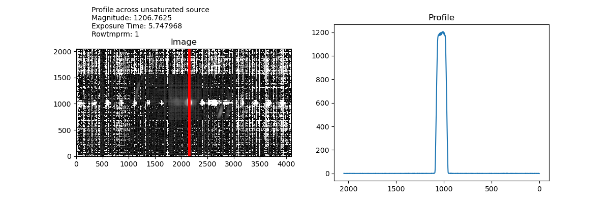
Plotting across Unsaturated Source
Some notes:
CMAP for Image is reversed
These are dark+pf corrected images
Exposure time is in ms
This is for 3x3 White 0.5x

Slide 9
Are we also seeing Crosstalk?

Slide 10
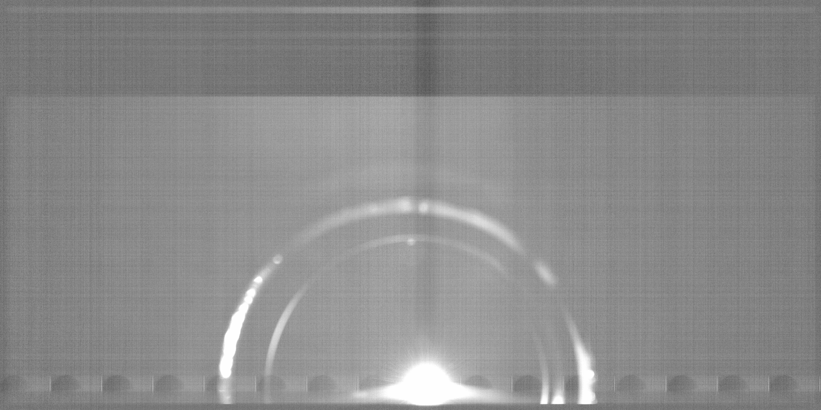

Slide 11
